Slide 1
University of Michigan-Flint &
Livingston County School Districts
Dual Enrollment Educational Partnership (DEEP)

Slide 2
Schools Participating in DEEP
Almont
Brandon
Brighton
Byron
Carman-Ainsworth
Clarkston
Clio
Corunna
Dryden
Durand
Fenton
Flushing
Fowlerville
Grand Blanc
Hartland
Holly
Howell
Imlay City
Laingsburg
Lake Fenton
Lake Orion
LakeVille
Lapeer
Linden
Montrose
Morrice
New Lothrop
North Branch
Owosso
Perry
Pinckney
Powers Catholic
Swartz Creek

Slide 3
What is a DEEP Student?
A DEEP student is a UM-Flint college student
that happens to still be in high school!

Slide 4
Benefits of DEEP
Earn college credit* while attending
Exposure to the rigor and pacing of college coursework
Ease the transition from high school to college
Reduce financial burden to families
Provide an advantage when applying to highly-competitive universities
*Although UM-Flint credits are widely transferable, colleges and universities maintain their own credit transfer policies

Slide 5
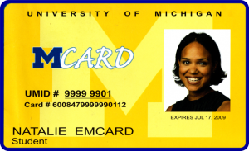
Student Services
Recreation Center
University of Michigan library system (Ann Arbor, Flint and Dearborn campus as well as online)
The Marian E. Wright Writing Center
Academic Advising
Many UM-Flint student activities, clubs, and events

Slide 6
Sample DEEP Schedule
FALL
Course 1 Mondays and Wednesdays (75 minutes each day)
Course 2 Tuesdays and Thursdays (75 minutes each day)
WINTER
Course 3 Mondays and Wednesdays (75 minutes each day)
Course 4 Tuesdays and Thursdays (75 minutes each day)

Slide 7
DEEP Courses
General Studies 12:30 - 1:45PM @ Hartland Educational Support Service Center
PHL 101, Intro to Philosophy, 3 credits
COM 204, Argumentation & Debate, 3 credits
HIS 114, 20th Century World History, 3 credits
POL 120, U.S. National Government & Politics, 3 credits
$6,900 value
Business/Economics 12:45 - 2:00PM @ Hartland Educational Support Service Center
BUS 110, Business Concepts & Careers, 3 credits
ECN 201, Principles of Economics (Macro), 3 credits
BUS 115, Intro to Business Applications, 3 credits
ECN 202, Principles of Economics (Micro) 3 credits
$6,900 value

Slide 8
DEEP Courses
Medical Science 12:30 - 2:05PM @ Hartland Educational Support Service Center
BIO 113, Principles of Biology, 4 credits
HCR 206, Health Sciences Applications, 2 credits
BIO 328, Genetics, 4 credits
PHL 202, Intro to Logic, 3 credits
$7,750 value
Pre-Engineering 12:45 - 2:10PM @ Hartland High School
CSC 175, Problem Solving and Programming 1, 4 credits
EGR 102, Introduction to Engineering, 3 credits
CSC 275, Problem Solving and Programming 2, 3 credits
EGR 165, Computer-Aided Design, 3 credits
$8,000 value

Slide 9
Tuition, Fees, & Textbook
Business/Economics Program
Estimated cost to student
$875 + textbooks
Medical/Science Program
Estimated cost to student
$1,575 + textbooks
General Studies Program
Estimated cost to student
$875 + textbooks
Pre-Engineering Program
Estimated cost to student
$1,800 + textbooks

Slide 10
Next Steps
Complete the UM-Flint Supplemental DEEP Application
Return the completed application to your counselor by Application Deadline
Complete Online Application as a group
APPLICATION DEADLINE
Friday, February 2, 2024

Slide 11
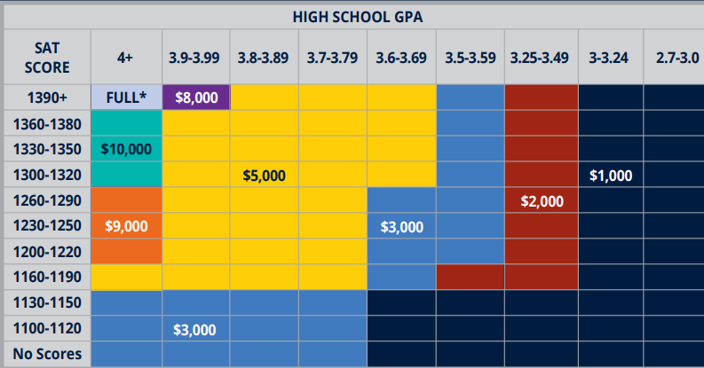
Standard Admission
GPA: 2.7+
SAT/ACT: Optional
Apply online: apply.umflint.edu/
Phone: (810) 762-3300
Email: admissions.flint@umich.edu
Notes:
Be sure to reiterate that current DEEP students who plan to continue on as first year students will need to complete a first-year application.
Boost the benefit to still being treated as a FY student as far as scholarships and housing is concerned

Slide 12
Contact Us
Main Office: flint.k12@umich.edu (810) 762-5987
SUZANNE KNIGHT, PhD Director suknight@umich.edu
Laura Martin Program Manager lamart@umich.edu
JEFF SHUEL Assistant Director jshuel@umich.edu
JOY MURRAY Administrative Specialist jomurray@umich.edu

